Slide 1
SE 2228 – C++

Slide 2
Pointers: Reference operator (&)
The address that locates a variable within memory is what we call a reference
to that variable. This reference to a variable can be obtained by preceding the
identifier of a variable with an ampersand sign (&), known as reference
operator, and which can be literally translated as "address of".
For example:
ted = &andy;

Slide 3
Pointers: Reference operator (&)
ted = &andy;
This would assign to ted the address of variable andy,
since when preceding the name of the variable andy
with the reference operator (&) we are no longer
talking about the content of the variable itself, but
about its reference
(i.e., its address in memory).

Slide 4
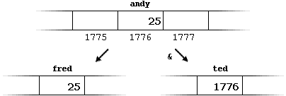
Pointers: Reference operator (&)
andy = 25;
fred = andy;
ted = &andy;

Slide 5
Pointers: Dereference operator (*)
Using a pointer we can directly access the value
stored in the variable which it points to. To do
this, we simply have to precede the pointer's
identifier with an asterisk (*), which acts as
dereference operator and that can be literally
translated to "value pointed by".

Slide 6
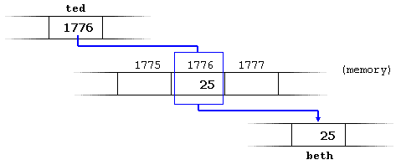
Pointers: Dereference operator (*)
beth = *ted;

Slide 7
Pointers: Dereference operator (*)
beth = ted;
// beth equal to ted ( 1776 )
beth = *ted;
// beth equal to value pointed by ted ( 25 )

Slide 8
Pointers
Notice the difference between the reference
and dereference operators:
& is the reference operator and can be read as "address of“
* is the dereference operator and can be read as "value pointed by"

Slide 9
Pointers: Declaring
Due to the ability of a pointer to directly refer to
the value that it points to, it becomes necessary
to specify in its declaration which data type a
pointer is going to point to. It is not the same
thing to point to a char as to point to an int or a
float.
Format:
type * name ;

Slide 10
Pointers: Declaring
#include <iostream>
using namespace std;
int main ()
{
int firstvalue, secondvalue;
int * mypointer;
mypointer = &firstvalue;
*mypointer = 10;
mypointer = &secondvalue;
*mypointer = 20;
cout << "firstvalue is " << firstvalue << endl;
cout << "secondvalue is " << secondvalue << endl;
return 0;
}
Output :
firstvalue is 10
secondvalue is 20

Slide 11
Pointers: Example
int main ()
{
int firstvalue = 5, secondvalue = 15;
int * p1, * p2;
p1 = &firstvalue; // p1 = address of firstvalue
p2 = &secondvalue; // p2 = address of secondvalue
*p1 = 10; // value pointed by p1 = 10
*p2 = *p1; // value pointed by p2 = value pointed by p1
p1 = p2; // p1 = p2 (value of pointer is copied)
*p1 = 20; // value pointed by p1 = 20
cout << "firstvalue is " << firstvalue << endl;
cout << "secondvalue is " << secondvalue << endl;
return 0;
}

